Slide 1




WELCOME TO
Sourcing & Marketing Strategies in Excellence!
2025

Slide 2





ABOUT US
We define ourselves as a client orientated Speciality Chemicals Provider and we love to
source speciality chemicals which are not well available on the world market!
Our goal is to help chemical, pharmaceutical and cosmetical companies to become more Independent from China & India with local alternative suppliers!
Sourcing Strategies in Excellence = Sostie!
2/11

Slide 3

Background of SOSTIE
Team:
Michael Hanzl
Doris Hanzl
Wolfgang Triebl
Marta Karchkhadze
Ekaterina Krasnocharova
Paul Lockyer
CEO
CFO
BD Industrial Chemicals
Sourcing Specialist
Business Development
- Business Development
We are a dynamic, motivated and sophisticated team with a high level of
experience in the chemical, pharmaceutical & biotechnological industry.

Slide 4

Our Services
We are specialized in sourcing and outsourcing
a
investigating the market and allocating a manufacturer for your product(s) in EE, CEE, US, Asia.
if required, we organize secrecy agreement between you and the potential partner.
supervising the whole process from your inquiry – to the final delivery.
coordinating the supply contact directly between client and manufacturer.
working with exclusive partners in Eastern/Central European, US and Asian manufacturers.
reporting periodically about the status of the process and keeping goals within time and budget plan.
We are marketing/selling products of and for clients and developing new markets

Slide 5


Sostie Network :
More than 100 manufacturing partners in the Sostie network
We cover big range of chemistries, scales, quality standards
From CRO via continuous flow technology up to big scale API production
—> from Lab development to big commercial scale
The network

Slide 6


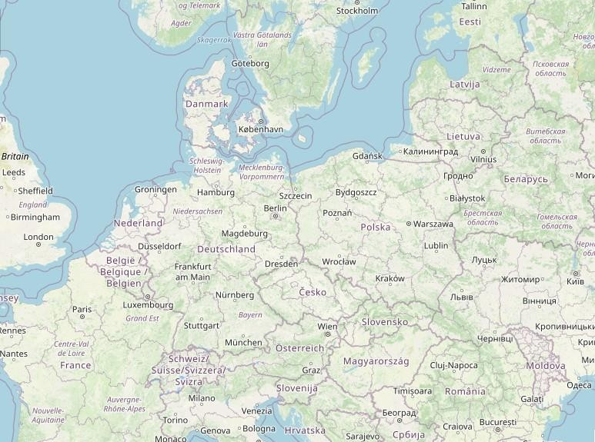

Locations of our main manufacturing partners:
+USA, India & China
The network

Slide 7
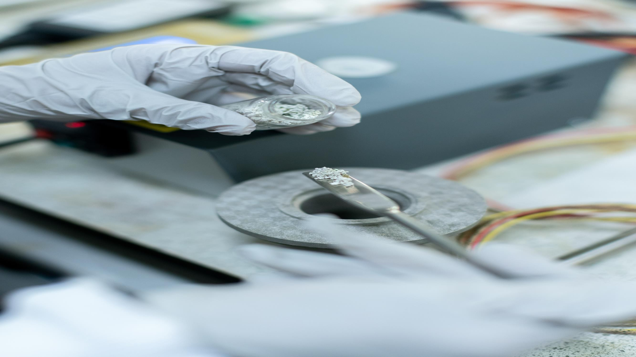

Specialty chemistry – Fine Chemicals Starting materials and RSM Cosmetical/Pharmaceutical Intermediates Electronical Industry (high purity products) cGMP Intermediates
Prostaglandine Intermediates HPAPI
API – human/veterinarian (EP, JP, US, BP etc.)
CRO capabilities (ROS development/optimization) Rare Sugars
Dyes
Diagnostic reagents
Essences of plants Biotechnology
Product range:

Slide 8



Recombinant protein and enzyme engineering
•
•
•
Enzyme characterization and manufacturing
Providing downstream processing, purification, final formulation services
Contract based and custom protein/enzyme expression
Up to 1000L of fermentation capacities
Capability of producing diverse set of microbiological products e.g. probiotics, bacterial soil fertilizers
Analytical and EU GMP related services
Our Biotech strengths
•
•
•
•

Slide 9


Our Main Clients and Their Locations
Specialty chemistry manufacturers
API manufacturers Biotechnology
Electronical industry Traders – distributors Pharmaceutical companies Diagnostic companies Food Industry
Cosmetic companies
From: Europe USA
Canada

Slide 10


Why Sostie - Why us?
We are a small, but well organized team - means we are fast in response and action
Small overhead costs - means fair pricing
Qualified partner network within the chemical industry - means trusted suppliers
Working with long term partners - means fair partnerships always last long
—> Our focus is always to find creative and reasonable ways to find solutions to
supply our clients with demanded product.

Slide 11




LET’S GET IN TOUCH!
SOSTIE in Austria:
SOSTIE OG
Tullnerstrasse 45
A-3425 Langenlebarn sales@sostie.com
+436604672587
SOSTIE in US:
SOSTIE Inc.
3665 Bonita Beach Road,
Suite 1-3
Bonita Springs, FL 34134 sales@sostie.com
SOSTIE IN LITHUANIA
SOSTIE UAB
J.Savickio g.4
LT-01108 Vilnius
sales@sostie.com
+37060500951
http://www.sostie.com/
https://www.linkedin.com/company/sostie-inc/

